Slide 1
MOVIE RECOMMEMDATION SYSTEM(S)
Presenter: David Musili

Slide 2


Introduction
WHAT DO WE LOOK FOR WHEN WE DECIDE TO WATCH A MOVIE??
Is the movie a new release?
What are the ratings?
What is the movie genre?
What is the movie plot?
Who are the actors/actresses?
Who is the movie director?
April 22, 2024

Slide 3
Movie RECOMMENDATION SYSTEM
Due to the numerous options we consider when we choose the movies we watch, we need more that one recommendation model (or system) to effectively make movie recommendations to users.
Profits are up in the last quarter by 3%
April 22, 2024

Slide 4

Dataset
tmdb_5000_movies.csv: contains movie information
tmdb_5000_credits.csv: contains movie metadata i.e. information that you find in the movie credits
This project used the files below
Acknowledgements
The csv files noted above were downloaded from Kaggle.
April 22, 2024

Slide 5
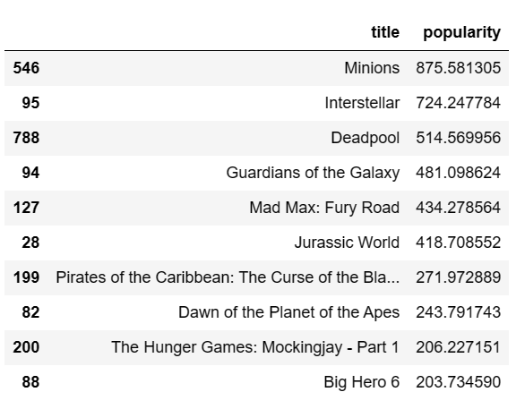
APPROACH #1
RECOMMENDING TOP MOVIES
1: Using Popularity column:
Using the ‘Popularity’ column of the input dataset, we are able to make recommendations of the top 10 most popular movies.
April 22, 2024

Slide 6

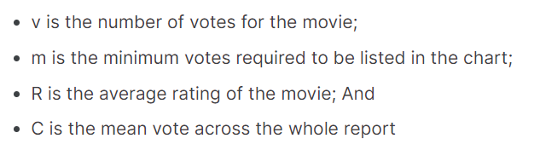
APPROACH # 2
RECOMMENDING TOP MOVIES
Profits are up in the last quarter by 3%
2: Using the *IMDB Weighted Average formular:
Used to average out votes and movie ratings
*IMDB= Internet Movie Database
April 22, 2024

Slide 7
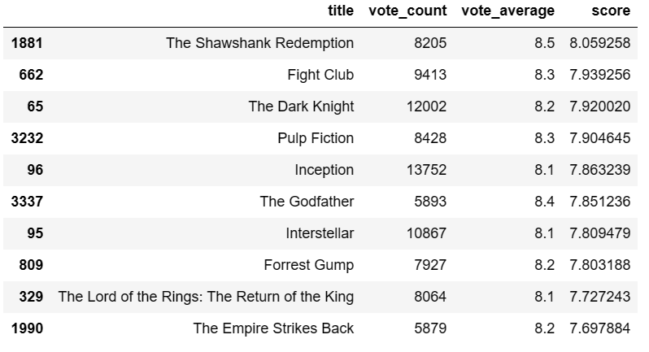
TOP MOVIES – IMDB FORMULAR
Profits are up in the last quarter by 3%
April 21, 2024

Slide 8
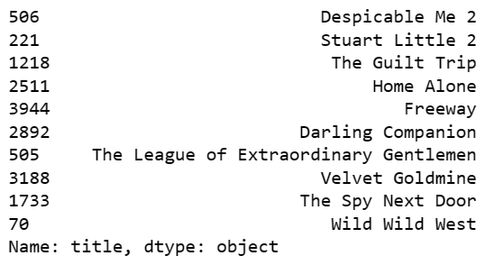
Content BASED Filtering
APPROACH #3
Movie Recommendation for ‘MINIONS’
3: Using TF-IDF Vectorizer
Use movie plot(overview) to recommend movies.
1) Data clean up:
Remove English stop words
Populate null columns with empty strings
2) Use cosine similarity to determine movie similarity scores and provide recommendations.
April 22, 2024

Slide 9
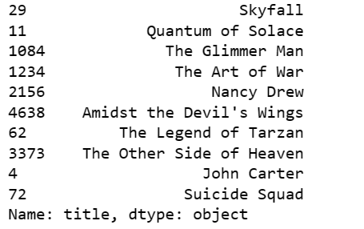
Content BASED Filtering
APPROACH #4
Movie Recommendation for ‘Spectre’
Using Count Vectorizer:
Use a combination of cast, keywords, director, genres to recommend movies. Count Vectorizer is used to now downplay any words.
Data clean up:
Remove English stop words
Populate null columns with empty strings
Concatenate the fields
Ensure all letters are lower case
Use cosine similarity to determine movie similarity scores and provide recommendations.
April 22, 2024

Slide 10
NEXT PHASE
Research Collaborative Filtering for Movie Recommendation System
April 22, 2024

Slide 11

THE END

